Slide 1
Student Interest System Project-enterprise system
Submit by:
ALI RAZA-BITF20M010

Slide 2
Table Content:
ER Diagram
Application Flow
Technologies
Color Schemes, Templates and Fonts

Slide 3
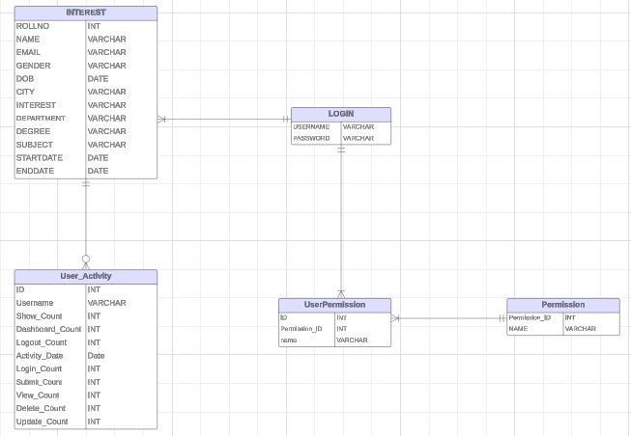
ER Diagram:

Slide 4
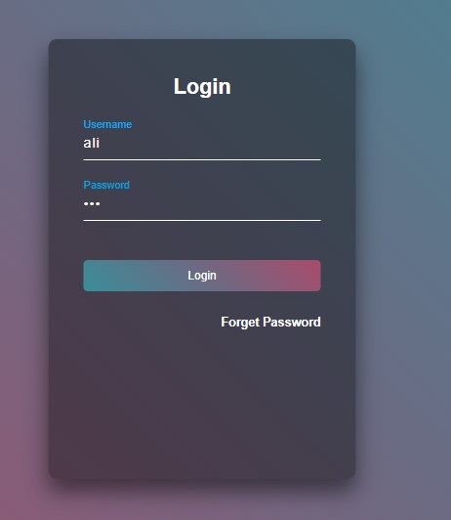
User Authentication:
User starts by logging into the system using secure credentials.

Slide 5
Student Registration:
After successful login, the user navigates to the "Add Student" section.
Fills out the form in the addStudent.html page.
Clicks on the "Submit" button to save the student details into the database.

Slide 6
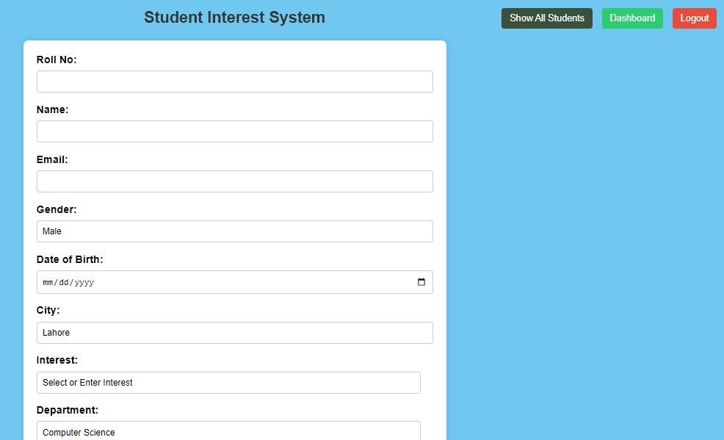
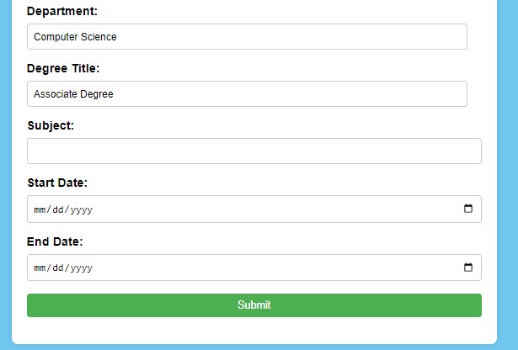

Slide 7
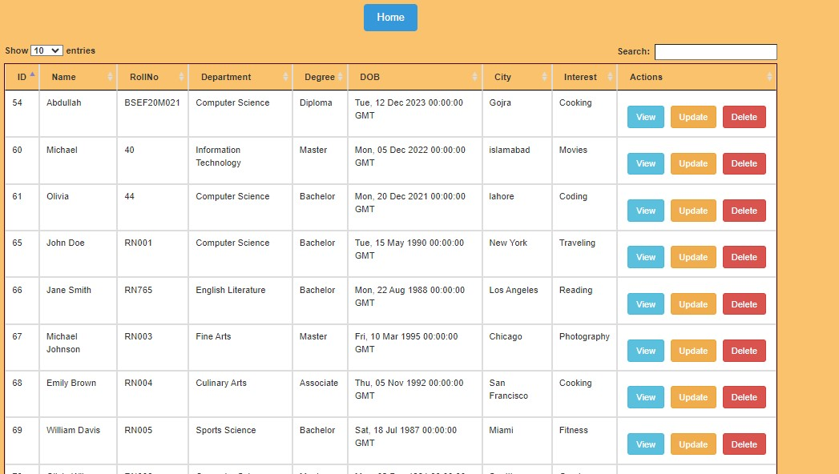
View All Students :
User can explore the list of all students in the system.

Slide 8
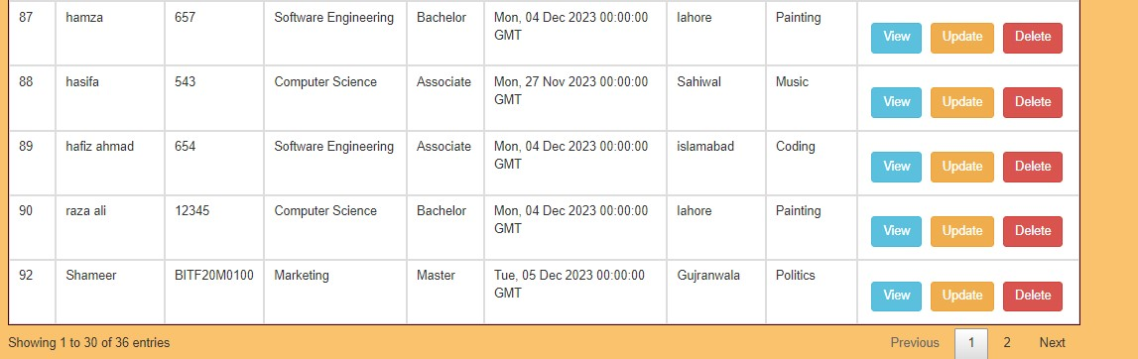
Cont……..:
User can explore the list of all students in the system.

Slide 9
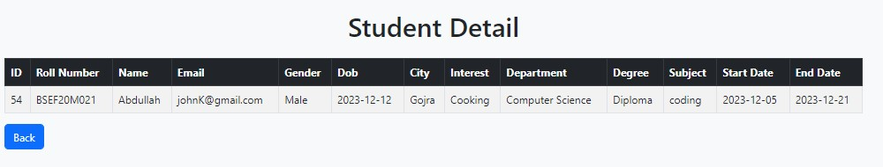
View Student Details:
Clicking on "View" retrieves and displays detailed information about a specific student.

Slide 10
Update Student Record:
Selecting "Update" redirects to a page where the user can modify student details.
After changes, the user clicks "Update" to save the modified information to the database.

Slide 11
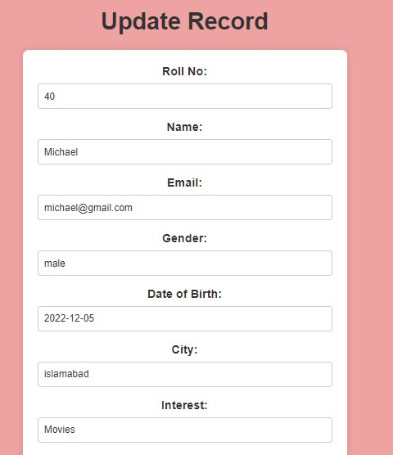
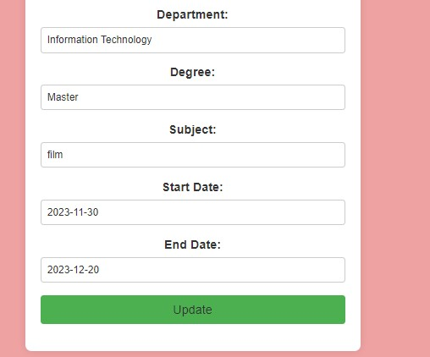
Cont….

Slide 12

Delete Student Record:
On Click "Delete" button the student record is removed from the database.

Slide 13
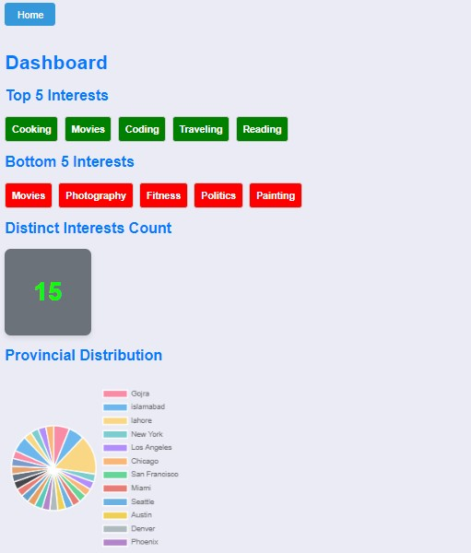
Dashboard screen:
When user click on dashboard button
User render to dashboard screen where all activities are stored which the user has performed.

Slide 14
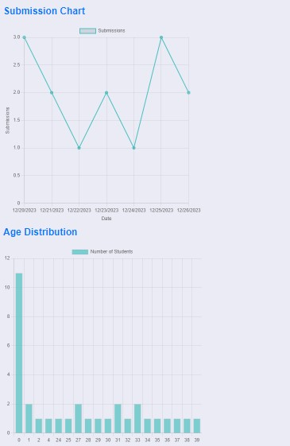
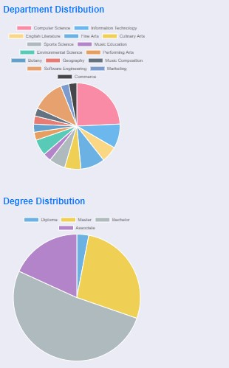
Cont…..:

Slide 15
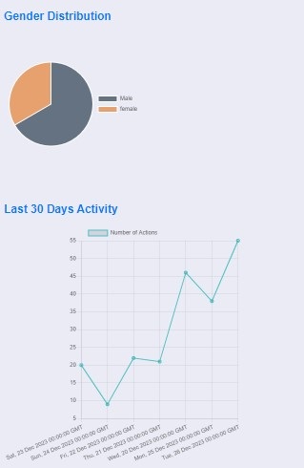
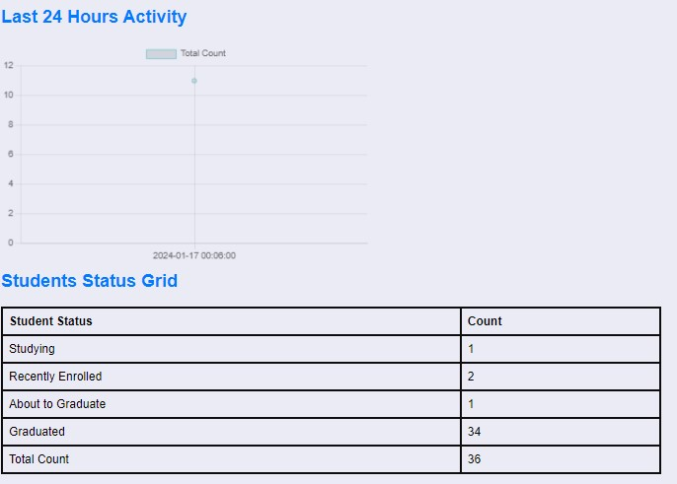
Cont…….:

Slide 16
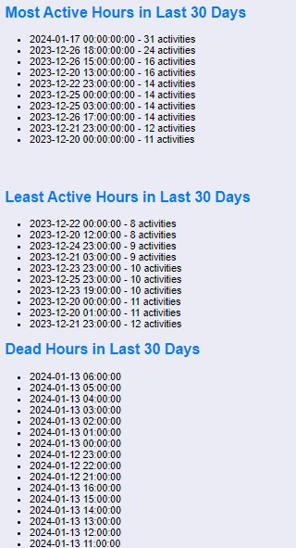
Cont…….:

Slide 17

Logout:
Upon choosing to logout, all user activities are recorded and stored in the database.
The user is securely redirected to the login page.

Slide 18
Technologies :
Flask
Python
MySQL (Database)
Ajex
Html
CSS
JavaScript
Bootstrap
I used these these technologies because I have already work on these technologies and it provide collectively contribute to a well-rounded web application, emphasizing simplicity, functionality, and a positive user experience. Flask and MySQL handle the backend, while HTML, CSS, JavaScript, Bootstrap, and AJAX contribute to a responsive and interactive frontend

Slide 19
Color , Fonts and Templates:
General Styling:
body: Sets the basic styling for the entire document. It uses a flexbox layout to center its content both vertically and horizontally. The background color is set to a gradient of three colors: #aa4b6b, #6b6b83, #3b8d99.
font-family: Sets the default font family for the document to 'Arial', sans-serif.
Container Styling:
.box: This class represents a container or a form with a translucent background. It has a fixed width, height, padding, and a box shadow for a card-like appearance. The background is set to a semi-transparent black color (rgba(0, 0, 0, .4)). It also has rounded corners with border-radius.
Header Styling:
.box h2: Styles the heading inside the .box container. It sets the color to white, centers the text, and adds some margin.
.box h5 and .box h4: Style additional headings inside the .box container with different margin and padding properties.
.box h4 a: Styles an anchor link within an h4 heading, setting the text decoration to none and color to #BE5869.
Form Input Styling:
.box .inputBox: Styles a container for form inputs, making it relative for positioning.
.box .inputBox input: Styles the input fields within the form, including width, padding, and border.
.box .inputBox label: Styles the labels for input fields, making them absolute and transitioning their position when the input is focused or has a value.

Slide 20
Cont…….
Button Styling:
.box button: Styles the button within the form, including width, padding, margin-top, background gradient, text color, border, border-radius, and cursor. The button also has a hover effect.
Media Queries:
Media queries are used to apply different styles for different screen sizes. For example, adjusting the width and height of the .box class based on the screen width.
Navigation Menu Styling:
ul and li: Styles an unordered list and list items.
ul li a: Styles links within list items, creating a navigation menu. It uses pseudo-elements to create a decorative effect on hover.
Responsive Design:
The CSS includes media queries to make the design responsive to different screen sizes, ensuring that the layout and styling adapt to various devices.
Page Container Styling:
.page-container: Styles a container for the page content with a maximum width, margin, padding, background color, border radius, and box shadow.
Dashboard Navigation Styling:
#buttons-container, #showData, #dashboard, #logoutLink: Styles for a navigation bar with buttons for different actions. It includes styling for button appearance, background colors, hover effects, and a transition.

Slide 21
THANK YOU

